Slide 1
R&D status and future strategy in KEK X-band area
May 16, 2011
T. Higo (KEK)

Slide 2
Contents
Situation after earthquake and recovery processes for KEK in Japan
KEKB accelerator recovery
X-band before March 11
Near future X-band activity for high gradient and LC
X-band for others, SuperKEKB

Slide 3
Japanese thank all of you from the world for giving us many warm words of sympathy and offering helps for recovery process.
We thank you, especially SLAC colleagues, for quickly taking over the host of this meeting.
Japan and KEK will suffer from budgetary and electric power limitation. By taking this chance we will make further advancements.

Slide 4
Earthquake and Tsunami for Japan
Japanese saying
1st Earthquake 2nd Thunder 3rd Fire 4th Father
Vibration
Level 6 at Tsukuba
My largest one in my life feeling actually fear
Still occur frequent little/medium ones
Tsunami
The biggest in 1000 years
No direct damage to most of Japan
Severe damage to Fukushima nuclear plants
→Shortage of electricity
→Spread of radioactive materials
Still several-month program for securely preservation

Slide 5
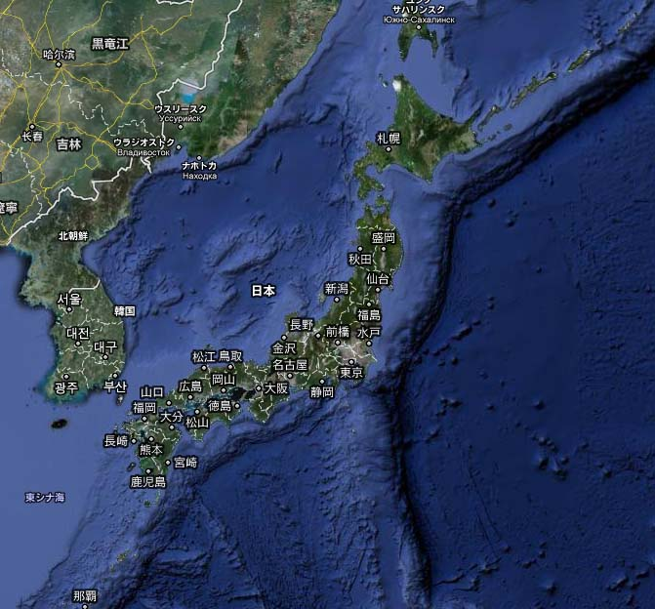
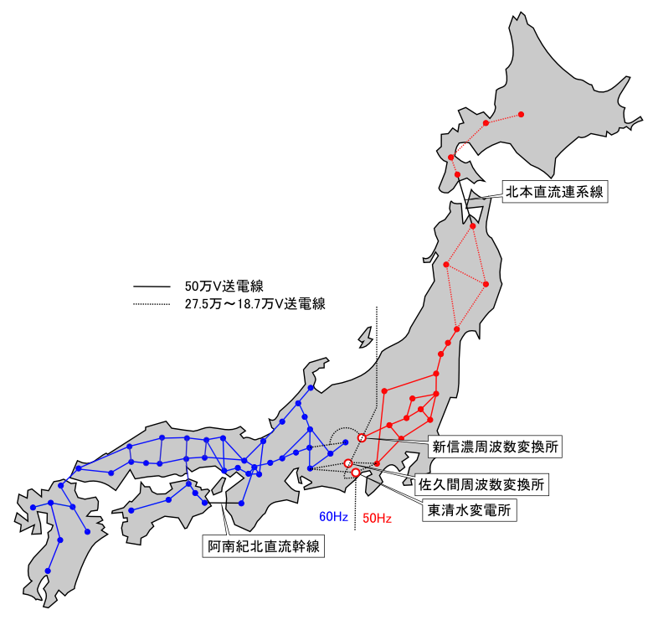
Japanese electricity situation

Slide 6
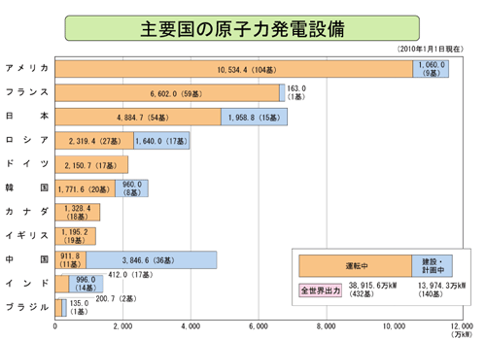
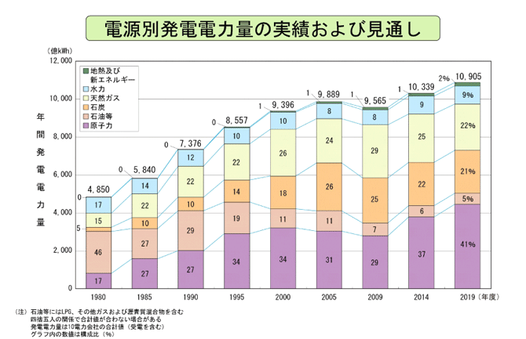
Nuclear plants

Slide 7
Japan / KEK electricity situation
Nuclear plants in Japan
  Soon 42 may be off out of 54 plants in Japan
  KEK needs to behave well mannered for cheap price setting
Available electric power level
  Allow more and more but gradually at KEK
  Still considerable effort is requested to keep low
  KEKB in construction phase → less power demand
  Typical power ~10MW daytime
Nationwide 15% saving is requested as a whole
  Light saving, programmed summer off plant, ……

Slide 8
KEK situation
General requirement
  Must below 24MW (max. contract)
  <20MW (-15% w.r.t. last summer)
  <18MW (-25% w.r.t. last summer) is recommended to escape from scheduled electric shortage
Office life
  Light is not turned on
  Air conditioner is OFF unless health requirement
  Recommended not to use elevator
  No light on the way to parking lot
High power facility
  Almost free if < 10kW (like Nextef)
  Need to confirm for >100kW (like CW machine)
  More power is available at night 22:00-06:00
  We hope these regulations are gradually decaying!?

Slide 9
Damage in KEKB linac to be converted to SuperKEKB injector
X-band colleagues and facilities are mostly working for KEKB which has been converting into SuperKEKB injector.
Damage to the linac is large
  Need to recover AND convert at the same time
  Main budget goes to these activities
X-band activity
  Try to keep the Nextef study activity
  Develop basic test stand at shield-B driven by KT1

Slide 10
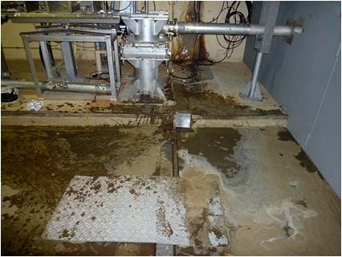
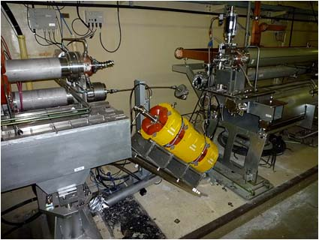
KEKB linac (1)
Water/mud mixture was sprung out at the expansion joint
Q magnets between hard and soft girders

Slide 11
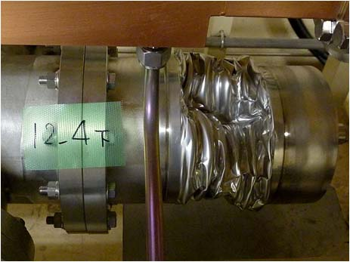
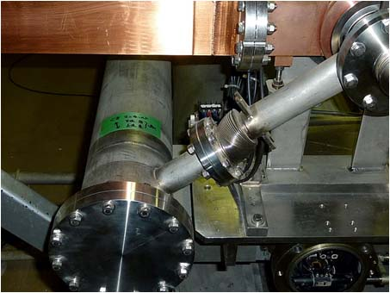
KEKB linac (2)
Vacuum manifold running parallel to the beam line to evacuate the acc structures
Bellows in the vacuum manifold was ruptured

Slide 12
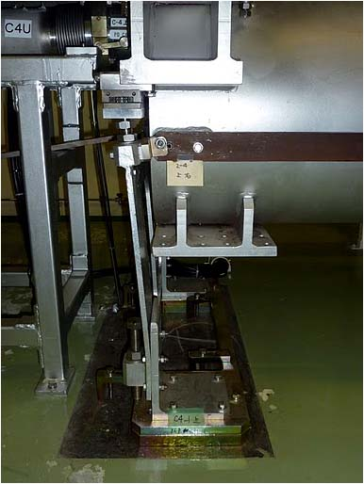
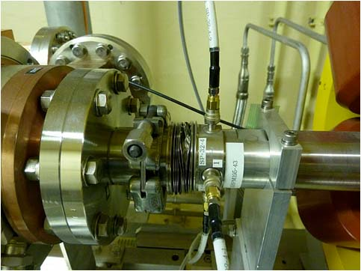
KEKB linac (3)
Connected to acc structure, BPM chamber bellow ruptured
Flexible plate supporting the 10m girder was bent more than elastic range

Slide 13
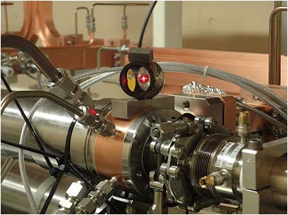
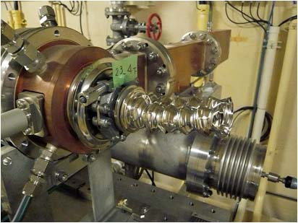
KEKB linac (4)
Re-alignment process is on-going to improve the alignment
Additional earthquakes make further disaster unless well protected

Slide 14
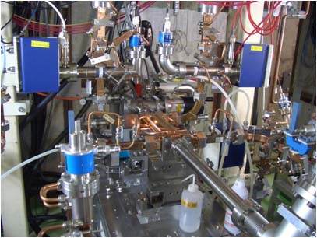
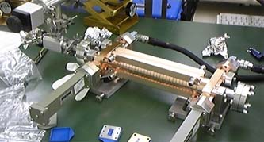
At Nextef
T24#3 has been operated until the earthquake
T24_Disk_#3
RF test before installation
T24_Disk_#3
High gradient test

Slide 15
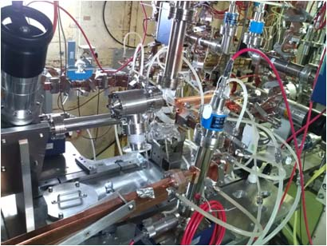
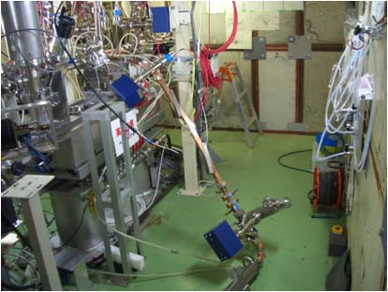
Nextef: before / after earthquake
Running T24
14:46 on March 11, 2011
Unfixed load was fallen
Accelerator structure was found to be atmospheric pressure.

Slide 16
X-band situation
High power facility
  Nextef can be operated fully
  KT1 can be also
  All klystrons are found alive
Fabrication / measurement
  Hydrogen furnace may not be operated easily
    Because it uses cooling water benefit from KEKB machine operation
  Ultra-precision room
    Air conditioner recently turned ON
    Hopefully we are allowed to keep it ON
      Precise RF measurement
      Mechanical inspection of precision parts

Slide 17
Nextef
Your supports and requests are very helpful
  for smoothly recovery to our previous experimental situation
  Collaboration framework
We struggle to establish
  High gradient tests of CLIC prototype structures
  Basic tests at shield-B

Slide 18
US/Japan cooperation is a key for worldwide collaboration
SLAC/KEK benefit is very large through US/Japan cooperation and it makes the base for overall framework!
Asian collab.
KEK
Structure fabrication
Infrastructure & test @ Nextef
Tsinghua
Structure design
Structure test and analysis @ Nextef
and others
US-Japan
CERN/KEK collaboration
US-HG
CLIC
SLAC conducts
Structure fabrication
High power test
Basic research
CERN financially supports for
Structure fabrication
High power test
System expansion
Recent test target comes from CLIC
Notes:
日米協力 SLAC・KEK 1990年代～
2006年～ CERN Xバンド高電界開発 関わる ＆ 共同研究体制 構築された
最近では、アジアのラボを含めた共同研究を開始
日米での共同研究はその基礎技術を提供
SLAK/KEKの設備、人材、経験 を有効に使って開発発展させることが 今後の展開のキーになっている

Slide 19
Recent encouraging result on T24

Slide 20
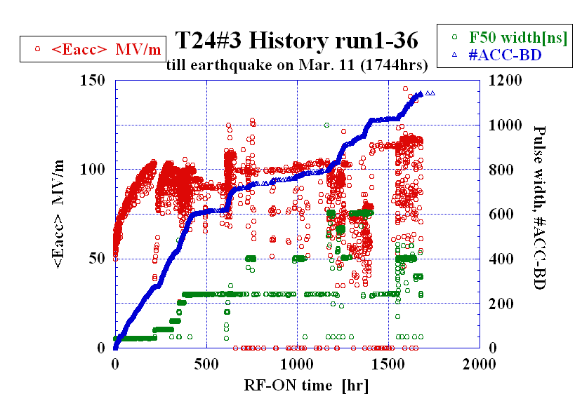
Processed for 1744 hours.

Slide 21
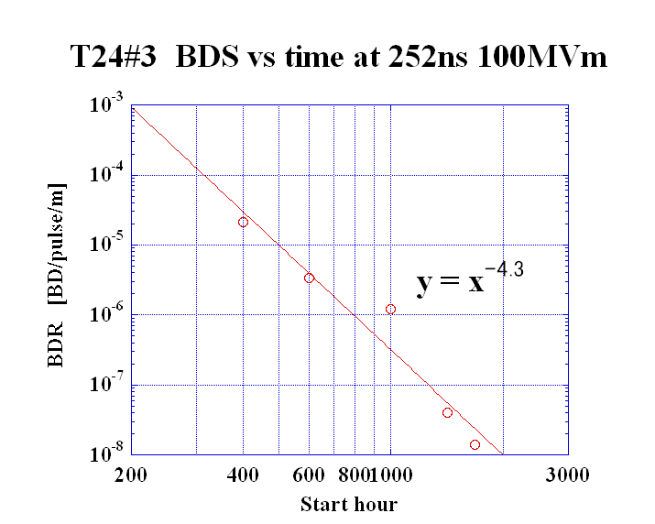
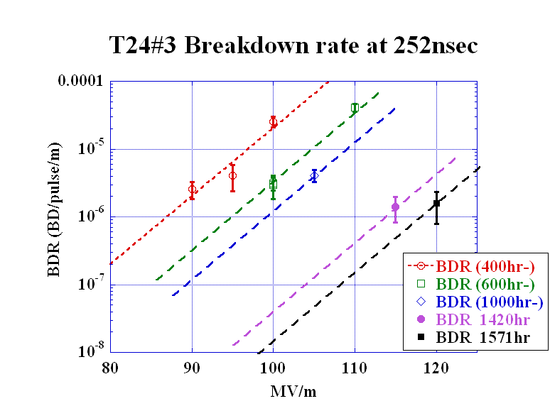
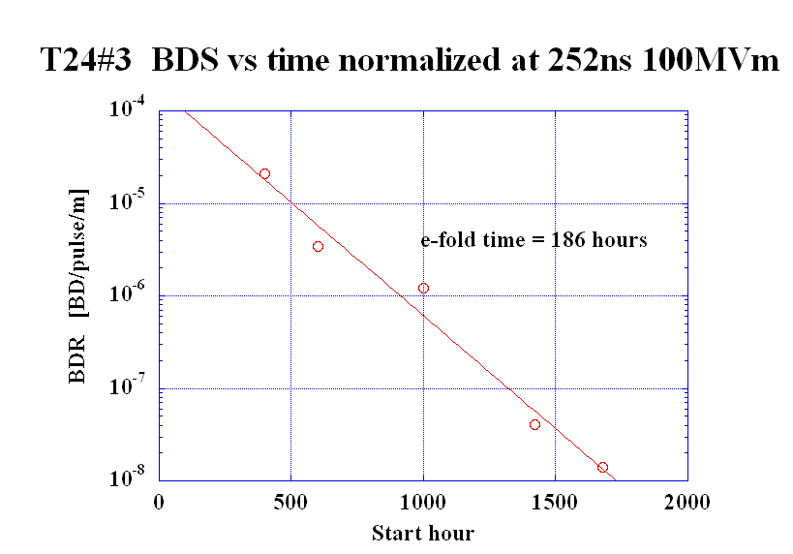
T24#3
BDR evolution at 252ns normalized 100MV/m
Assuming the same exponential slope as that at 400hr
We understood the BDR has been kept decreasing.

Slide 22
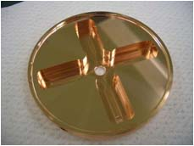
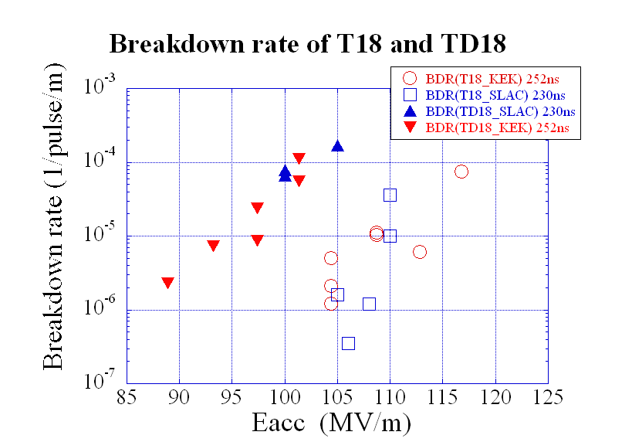
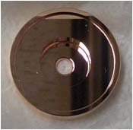
Comparison of BDR in
T18, TD18 and T24
TD18#2
1600hrs
400hrs
T24#3
1677hrs
T18#2
T18 T24
2800hrs
Notes:
Damped 放電頻度 約100倍
温度上昇か？？

Slide 23
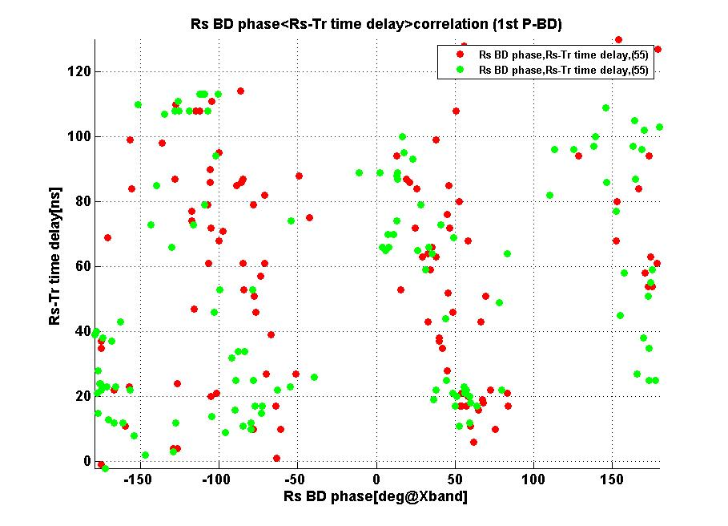
Rs reflection phase observed in T24 structure
Frequency change
+1MHz.
Body temp change
IQ amplitude dependence
<< MHz
Damage through operation if not due to change during vac bake?
Rs phase
20110108~20110117,pulse width 252ns;
Red point is ACC BD, green is 1st BD;

Slide 24
T24#3 summary
T24#3 has kept running at 120MV/m with 252nsec until the earthquake occurred at 14:46 on March 11.
High power operation has been done for 1744 hours.
BDR has kept decreasing, with e-fold time of 186 hrs or 4th power of elapsed time.
Double-pulse study show a little more BDR for the latter pulse by at most factor 2.
BDR of T24 reached w.r.t. T18
  Better for BDR vs Eacc, but
  Worse for BDR vs pulse heating ΔT
Dark current spectrum
  Shows detailed shape by higher resolution meas.
T24 shows encouraging BDR result
  → Need to evaluate the TD24

Slide 25
T24 → TD24
T24#3 has kept running at 120MV/m with 252nsec until the earthquake occurred at 14:46 on March 11. It was exposed to air to 0.1MPa.
Finished T24 and prepare for TD24.
!! We will try to measurement dark current routinely and automatically
?? Want to think about the on-line monitoring of damage by measuring the total phase advance
!? Improve vacuum level around acc structure

Slide 26
Re-establishing test facilities

Slide 27
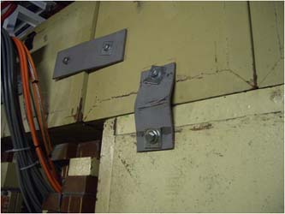
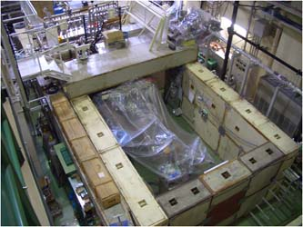
Nextef: Shield room
Blocks realignment was finished.
Blocks were mutually shifted by several cm!

Slide 28
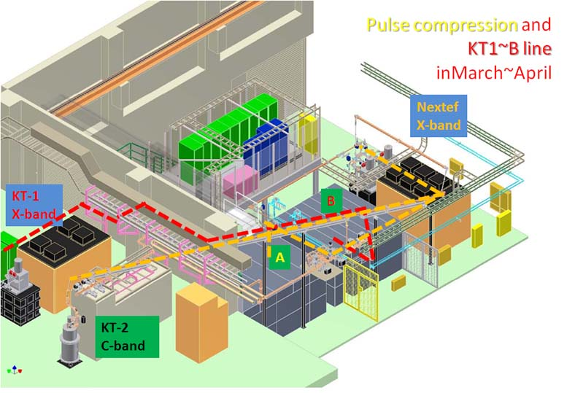
Nextef expansion is being proceeded

Slide 29
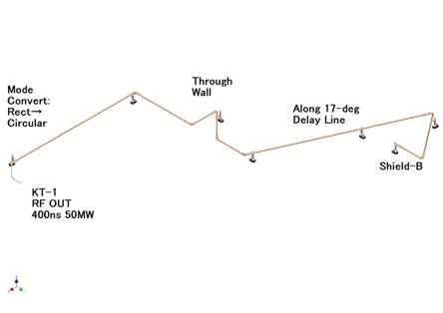
Building transfer line KT1--B

Slide 30
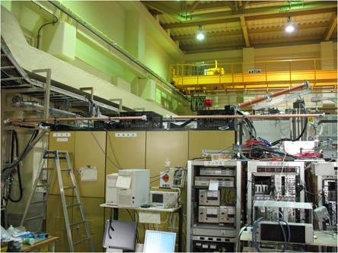
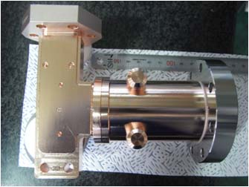
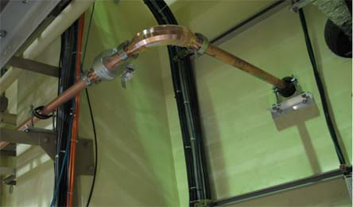
KT1 – B
Line is now being constructed.

Slide 31
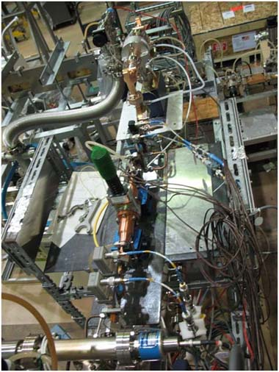
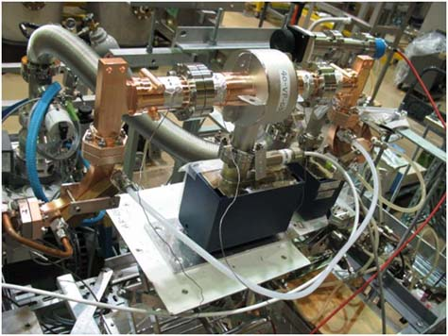
High power tests of components
Waveguide valve and mode convertor have been tested.

Slide 32
Nextef near future plan (May 2011)
2011 2012
5 6 7 8 9 10 11 12 1 2 3 4 5 6 7 8 9 10
TD24_Disk_R05 ??
Restartup
TD24_Disk #3
Tsinghua -made??
TD24_Disk_R05
KEK-made ??
Nextef-A
PC construction and commissioning ??
KT1-B
KT1 → B connection
1st single-cell
2nd single-cell
Power into shield-B
3rd single-cell

Slide 33
Preparation of basic test setup

Slide 34
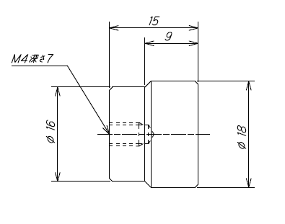
Test coupons for surface inspection
We want to study various surface and crystal features related to many treatments
Milling / turning
Light / heavy CP
Edge change due to high temperature process
Crystal growth on vac/gas at high temperature
Etc.
Suitable to the present situation with very limited power availability??

Slide 35
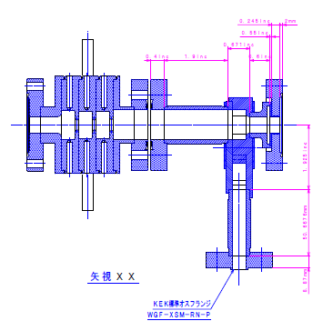
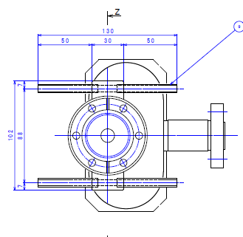
Single-cell setup for undamped / damped
The center cell will be
Valery-Higashi high-shunt impedance cell or T24
and with or without heavy damping waveguides.
Thinking to make the same setup for SLAC and KEK.

Slide 36
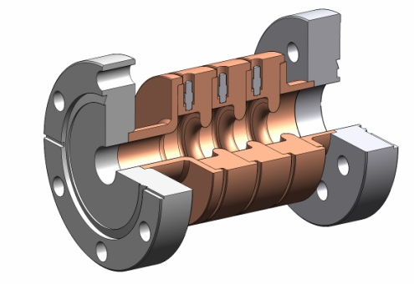
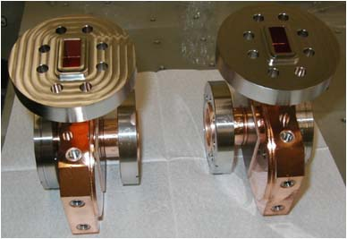
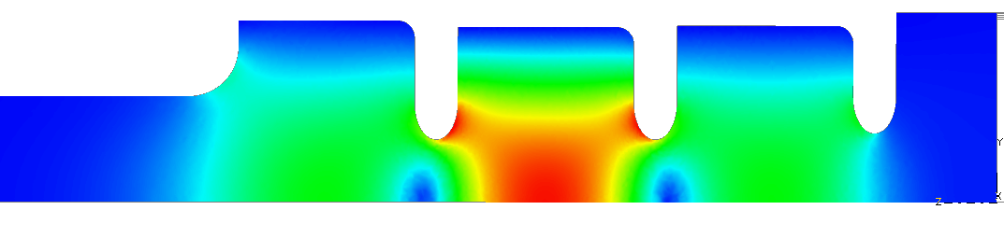
Reusable coupler: TM₀₁ Mode Launcher
Surface electric fields in the mode launcher E_{max}= 49 MV/m for 100 MW
SLAC made a set of launchers for KEK basic tests.
KEK will prepare single cell test setups.
Notes:
基礎試験用
モードロンチャー SLAC製 → KEKで使用
単セル空洞 を 今後の日米資金と協力関係を元に 製作 ＋ 試験 できる

Slide 37
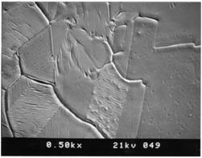
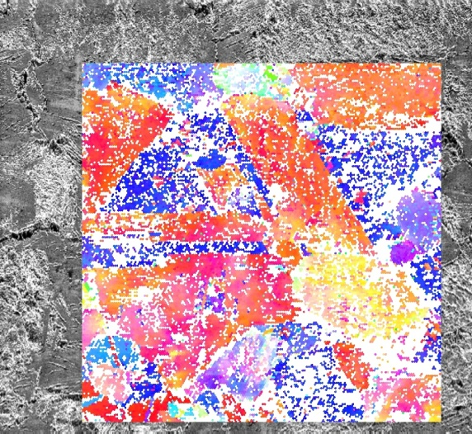
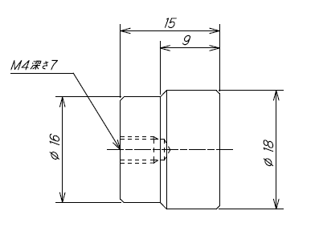
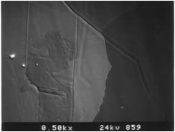
Systematic study on surface treatment is planned in collaboration
Cutting, HIP, purity, heat treatment, CP, EP, etc.
with using LG (high purity large grain material)
in coupon or single cell setup
VAC furnace
Crystal orientation
SEM & X-ray
Field Emission Microscope
Hydrogen furnace
Notes:
特に
結晶構造に着目

Slide 38
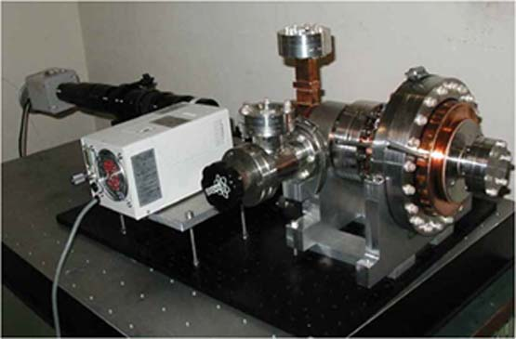
In-situ inspection of pulse heating sample collaboration between SLAC and KEK
Already shipped to SLAC to be installed.

Slide 39
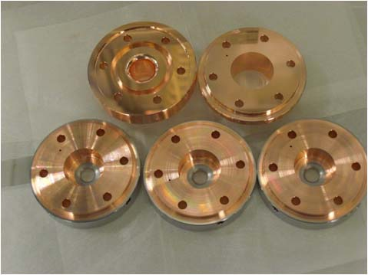
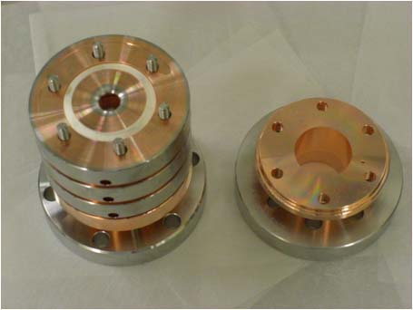
1C-SW-A3.75-T2.60-Cu/Mo-clamped
Test with other materials than copper, such as stainless steel and molybdenum for higher gradient.
KEK supplies the test setups without high temperature bonding but with knife-edge ring to vacuum seal.
Notes:
放電しても大丈夫な構造
Mo等のアイリス材料での試験 → 可能なら取り入れて 100MV/m超の電界の実現へ

Slide 40
Structure parts fabrication
TD24R05
  All done but many of disks, especially after earthquake, are not good in flatness.
  Under thinking to apply additional cut at both end flat surfaces
TD24R05(for KEK assembly)
  Practical strategy is under discussion.
TD24R05(12GHz)
  Will start right after 11.4GHz TD24R05.
DDSA(12GHz)
  Some of the features, relaxed roughness, finite steps, shorter cell design, are under discussion.
  Test cell cut was proposed to be discussed finally in Oct. this year.

Slide 41
KEK fabrication of whole structure
Aim
  Make the whole structure in Japan lead by KEK
  Within this fiscal year for KEK to get the actual fabrication
Practical
  Use existing parts from company Tohoku area
  May use partially hydrogen-filled vacuum furnace
    replacing hydrogen furnace which may not be recovered soon
  No vacuum baking is applied
    Because of too expensive for present KEK
    And may not be necessary → how to confirm?
  May apply CP for Higashi-Dolgashev typical

Slide 42
Conclusion
We sincerely appreciate all of your help.
The high gradient test of T24 was finished with the encouraging aspect.
Definitely we shall continue the prototype evaluation with the next importance TD24.
This year we will expand study into more basic experimental ones.
Please come to Japan in next spring and celebrate the safe control of nuclear plants.
Then and there, let us discuss our future direction, hopefully with more input from physics demand.

